Slide 1
THEORY OF DEMAND
HS201

Slide 2
What is Demand in Economics ?
Demand refers to how much (quantity) of a product or service is desired by buyers.
An economic principle that describes a consumer's desire and willingness to pay a price for a specific good or service.
Generally price of a good or service increases as its demand increases and vice versa.

Slide 3
Theory Of Demand
Demand theory is the analysis of the relationship between the demand for goods or services and prices or incomes.
Demand theory examines purchasing decisions of consumers and the subsequent impact on prices.

Slide 4
Cont…
The law of demand is normally depicted as an inverse relation of quantity demanded and price.
the higher the price of the product, the less the consumer will demand.

Slide 5
Determinants of individual demand
The main determinants of individual demand are the
price of the good,
level of income,
personal tastes,
the price of substitute goods, and
the price of complementary goods .

Slide 6
Demand schedule
  A table or list showing the number of units of a single type of good (or service) that potential purchasers would offer to buy at each of a number of varying prices during some particular time period.
  Demand Schedule of Laptops by IITP Students
Price per Laptops | Quantity Demanded
Rs.1.5 Lakhs | 01
Rs.1.0 Lakhs | 02
Rs. 75,000 | 04
Rs. 55,000 | 06
Rs. 50,000 | 08

Slide 7
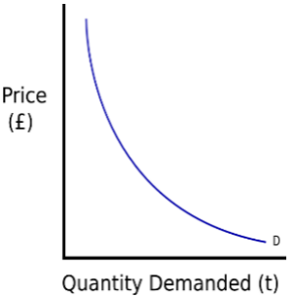
The demand curve
The demand curve is a graph which depicts the relationship between the price of a certain commodity and the amount of it that consumers are willing and able to purchase at that given price (demand).
This negative slope is often referred to as the "law of demand," which means that when all things but price are held equal, if the price of the good/service increases, the less of that good/service will be purchased by consumers.

Slide 8
Cont…
The demand curve usually slopes downwards from left to right; that is, it has a negative association (for two theoretic exceptions, see Veblen goods and Giffen Goods.
More graphs on movement along the demand curve and the shift of the demand curve are being discussed on the Board.

Slide 9
Why Demand Curves Slopes Downwards ?
There are at least three accepted explanations of why demand curves slope downwards:
The Law of Diminishing Marginal Utility
The Income Effects
The Substitution Effects

Slide 10
Law of Diminishing Marginal Utility
.
The law of diminishing marginal utility suggests that as more of a product is consumed the marginal (additional) utility of the consumer declines , therefore consumers are ready to pay less.
Pizza | TOTAL UTILITY | MARGINAL UTILITY
1 | 100
2 | 190 | 90
3 | 270 | 80
4 | 340 | 70
5 | 400 | 60
6 | 450 | 50
7 | 490 | 40
8 | 520 | 30
8 | 540 | 20

Slide 11
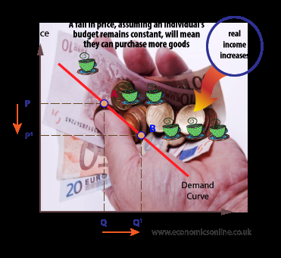
The Income Effect
The income effect proposes that, as the price of a good declines, real income - that is, what consumers can buy with their money income - rises and therefore consumers increase their demand.
Contrary to this a rise in price will reduce real income and force consumers to cut back on their demand.

Slide 12
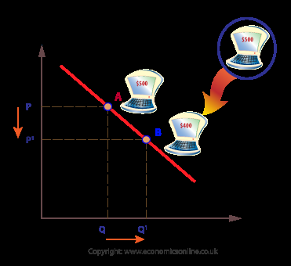
The Substitution Effects
Adding to our previous discussion on income effects, a fall in the price of a good makes that particular good relatively less expensive.
Consequently, presuming other alternative products on the same price, at reduced prices the good appears cheaper, and consumers will switch over from the costly alternative to the relatively cheaper one.

Slide 13
Exceptions to the Law of Demand :Veblen goods
When people's preference for buying a product is a direct function of their price are named as Veblen goods .
However, it is claimed that some types of high-status goods, such as expensive wines or perfumes are Veblen goods, in that decreasing their prices decreases people's preference for buying them because they are no longer perceived as exclusive or high status products.
The Veblen effect is named after the economist Veblen , who first pointed out the concepts of conspicuous consumption and status-seeking.

Slide 14
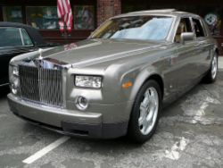
Veblen goods
Luxury cars are often stated to be desirable due to their price, which generates a certain amount of status. As a result one may argue that luxury cars are Veblen goods.

Slide 15

Exceptions to the Law of Demand :Giffen good
A good is a Giffen good if a rise in its price makes people buy even more of the product.
Giffen goods may or may not exist in the real world, but there is an economic model that explains how such a thing could exist.
When price goes up, the quantity demanded also goes up, and vice versa.
In order to be a true Giffen good, price must be the only thing that changes to get a change in quantity demand.

Slide 16
Giffen goods…..
The standard instance given by Marshall is of inferior quality staple foods , whose demand is driven by poverty that makes their purchasers unable to afford superior foodstuffs.
Read: Greg Mankiw's, (Professor of Economics, Harvard University) Blog http://gregmankiw.blogspot.in/2013/07/on-au.html
As the price of the cheap staple rises, they can no longer afford to supplement their diet with better foods, and must consume more of the staple food. Makiew cite the example of Rice as a staple food in China.

